Slide 1
Chapter 29
Halliday & Resnick’s
Fundamentals of Physics
By Jearl Walker
Magnetic Fields due to Currents

Slide 2
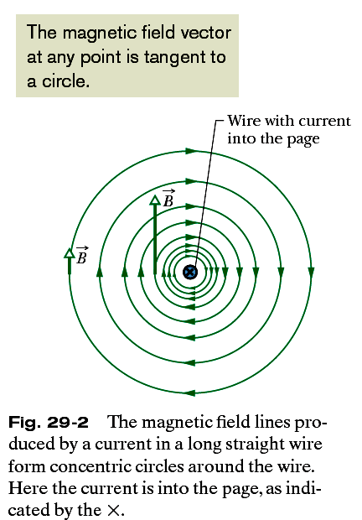

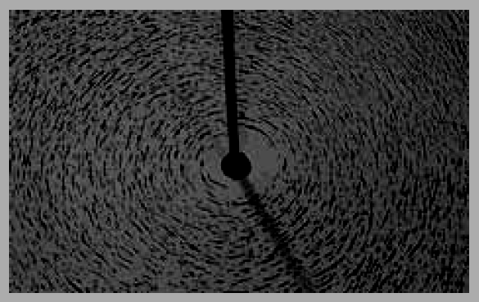
29.2: Magnetic Field due to a Long Straight Wire:
The magnitude of the magnetic field at a perpendicular distance R from a long (infinite) straight wire carrying a current i is given by
In electromagnetism, permeability is the measure of the ability of a material to support the formation of a magnetic field within itself. Hence, it is the degree of magnetization that a material obtains in response to an applied magnetic field.
Fig. 29-3 Iron filings that have been sprinkled onto cardboard collect in concentric circles when current is sent through the central wire. The alignment, which is along magnetic field lines, is caused by the magnetic
field produced by the current. (Courtesy Education Development Center)

Slide 3
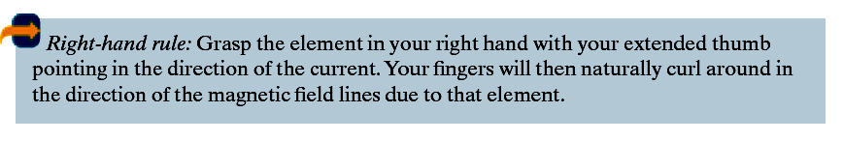
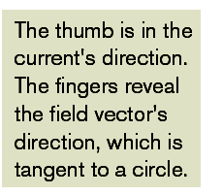
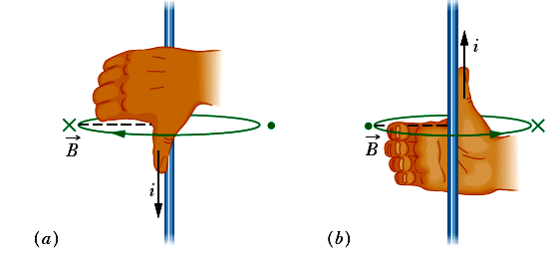
29.2: Magnetic Field due to a Long Straight Wire:
Fig. 29-4 A right-hand rule gives the direction of the magnetic field due to a current in a wire. (a) The magnetic field B at any point to the left of the wire is perpendicular to the dashed radial line and directed into the page, in the direction of the fingertips, as indicated by the x. (b) If the current is reversed, at any point to the left is still perpendicular to the dashed radial line but now is directed out of the page, as indicated by the dot.

Slide 4
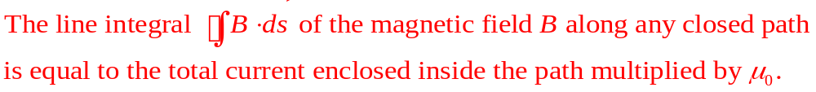
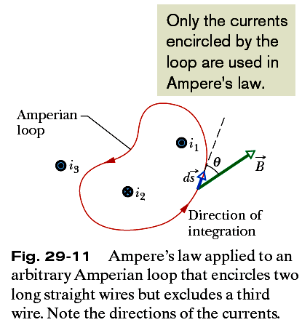
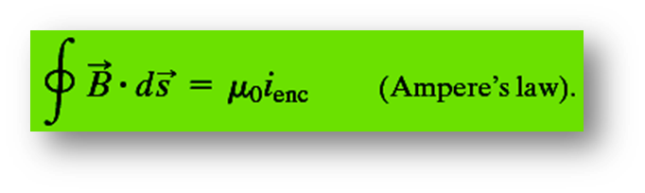
29.4: Ampere’s Law:
The ds is the current-length element vector along the direction of an Amperian loop.

Slide 5
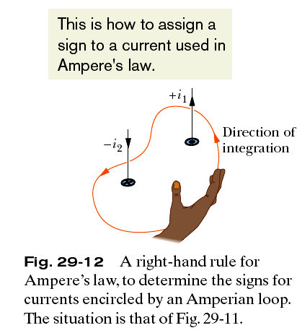
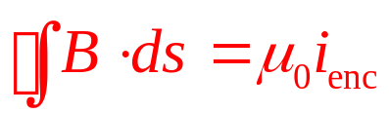
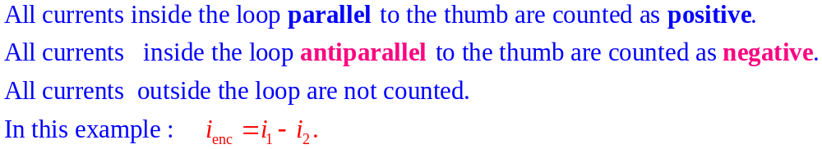
Determination of all B.ds. The closed path is divided into n elements and take their sums.
Curl your right hand around the Amperian loop, with the fingers pointing in the direction of integration.
A current through the loop in the general direction of your outstretched thumb is assigned a plus sign, and a current generally in the opposite direction is assigned a minus sign.

Slide 6
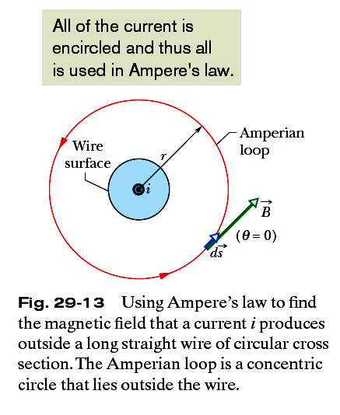

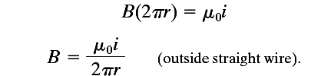
29.4: Ampere’s Law, Magnetic Field Outside a Long Straight Wire
Carrying Current:

Slide 7
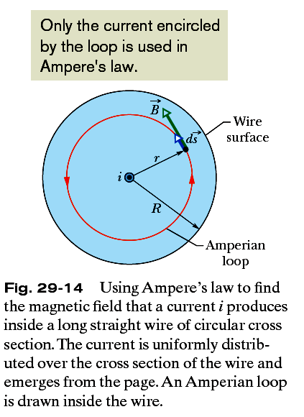




29.4: Ampere’s Law, Magnetic Field Inside a Long Straight Wire
Carrying Current:

Slide 8
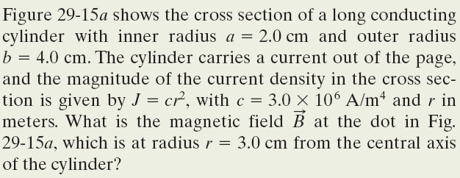
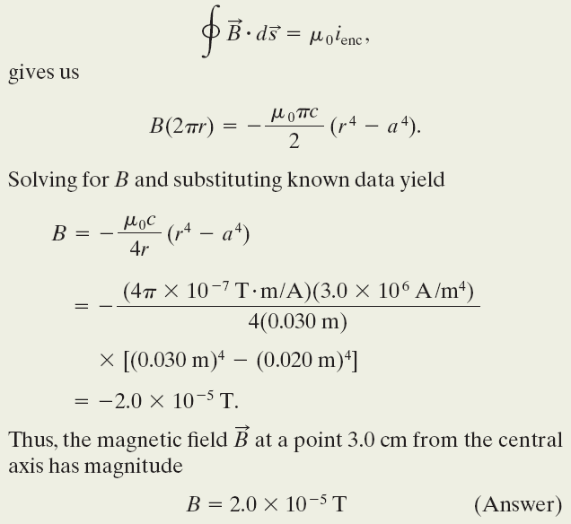
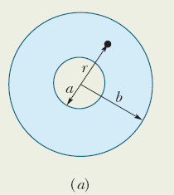
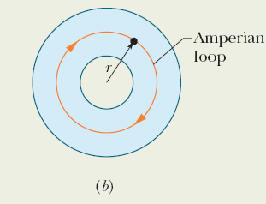
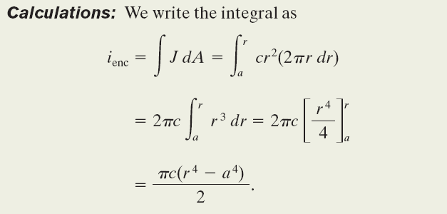
Example, Ampere’s Law to find the magnetic field inside a long cylinder of current.
Note: Here direction of Amperian loop is in clockwise direction, therefore the enclosed current direction will be taken negative.

Slide 9
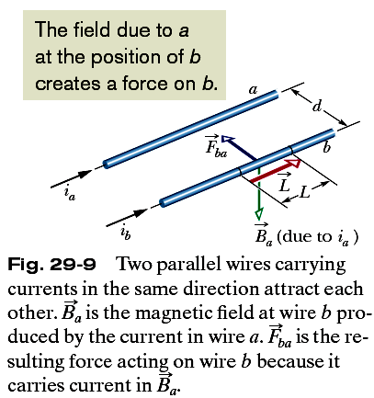



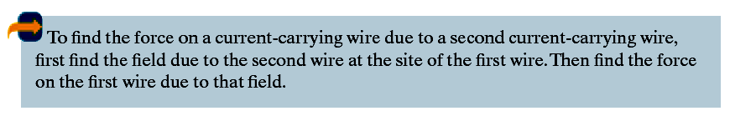
29.3: Force Between Two Parallel Wires:

Slide 10
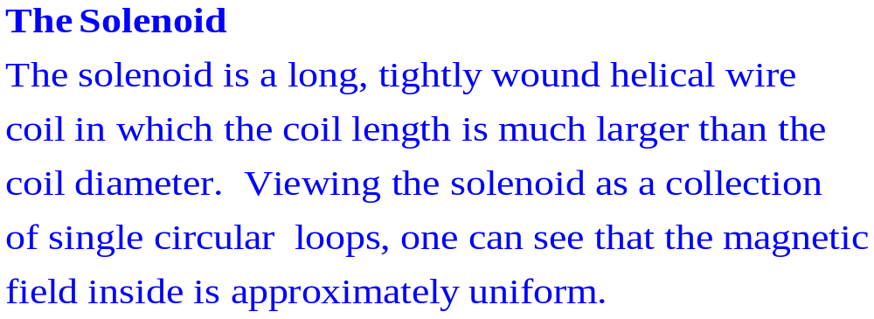
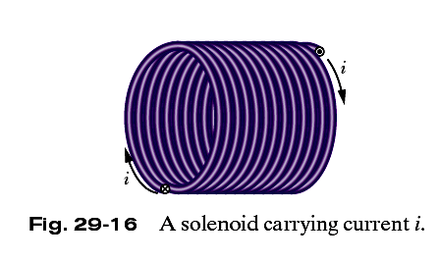
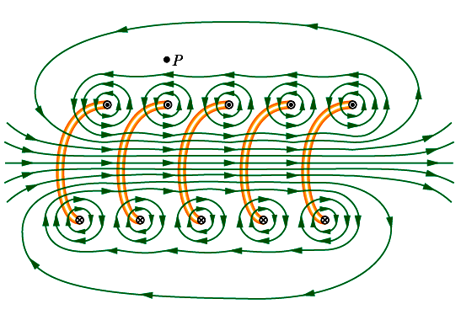
Fig. 29-17 A vertical cross section through the central axis of a “stretched-out” solenoid.
Each turn produces circular magnetic field lines near itself.
Near the solenoid’s axis, the field lines combine into a net magnetic field that is directed along the axis.
The closely spaced field lines there indicate a strong magnetic field.
Outside the solenoid the field lines are widely spaced; the field there is very weak.

Slide 11
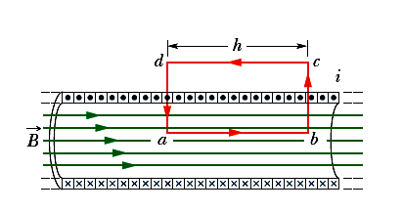
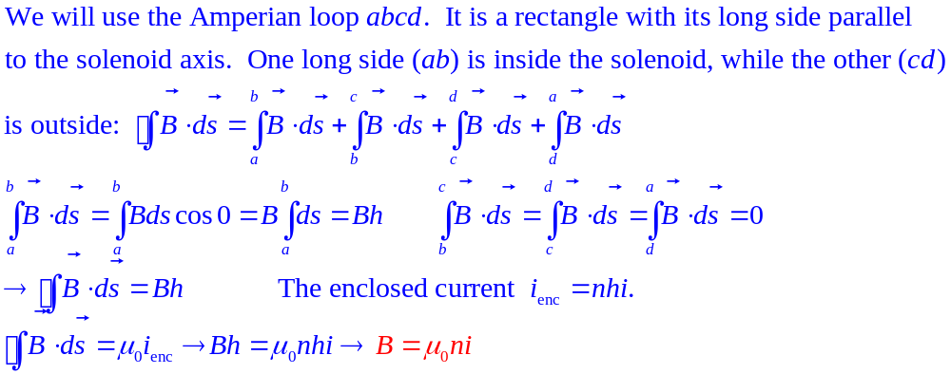
29.5: Solenoids:
Fig. 29-19 Application of Ampere’s law to a section of a long ideal solenoid carrying a current i. The Amperian loop is the rectangle abcda.
Here n be the number of turns per unit length of the solenoid

Slide 12
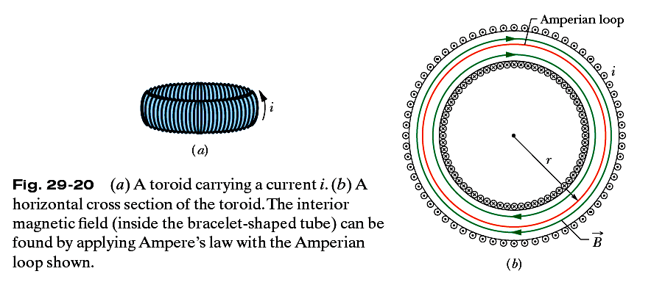

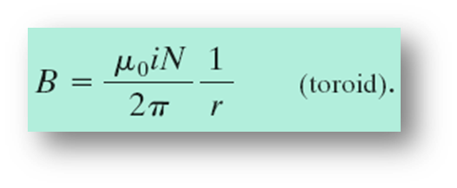
29.5: Magnetic Field of a Toroid:
A Toroid which we may describe as a (hollow) solenoid that has been curved until its two ends meet, forming a sort of hollow bracelet.
where i is the current in the toroid windings (and is positive for those windings enclosed by the Amperian loop in the form of a circle) and N is the total number of turns.

Slide 13
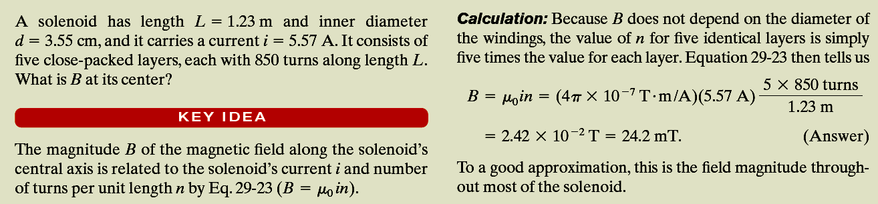
Example, The field inside a solenoid:

Slide 14
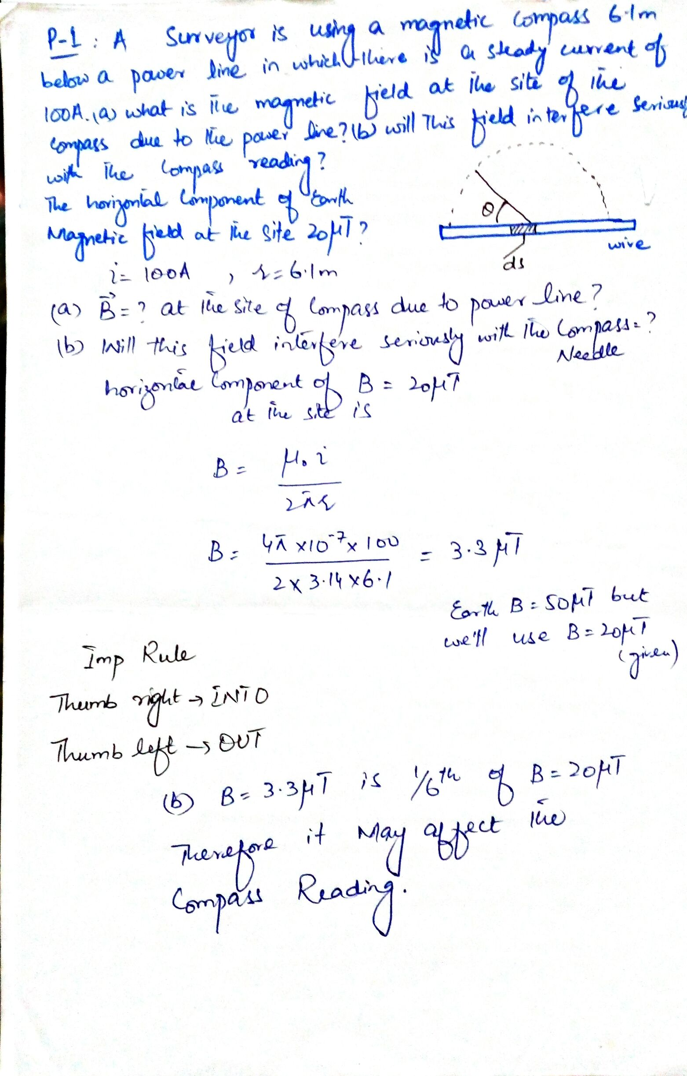

Slide 15
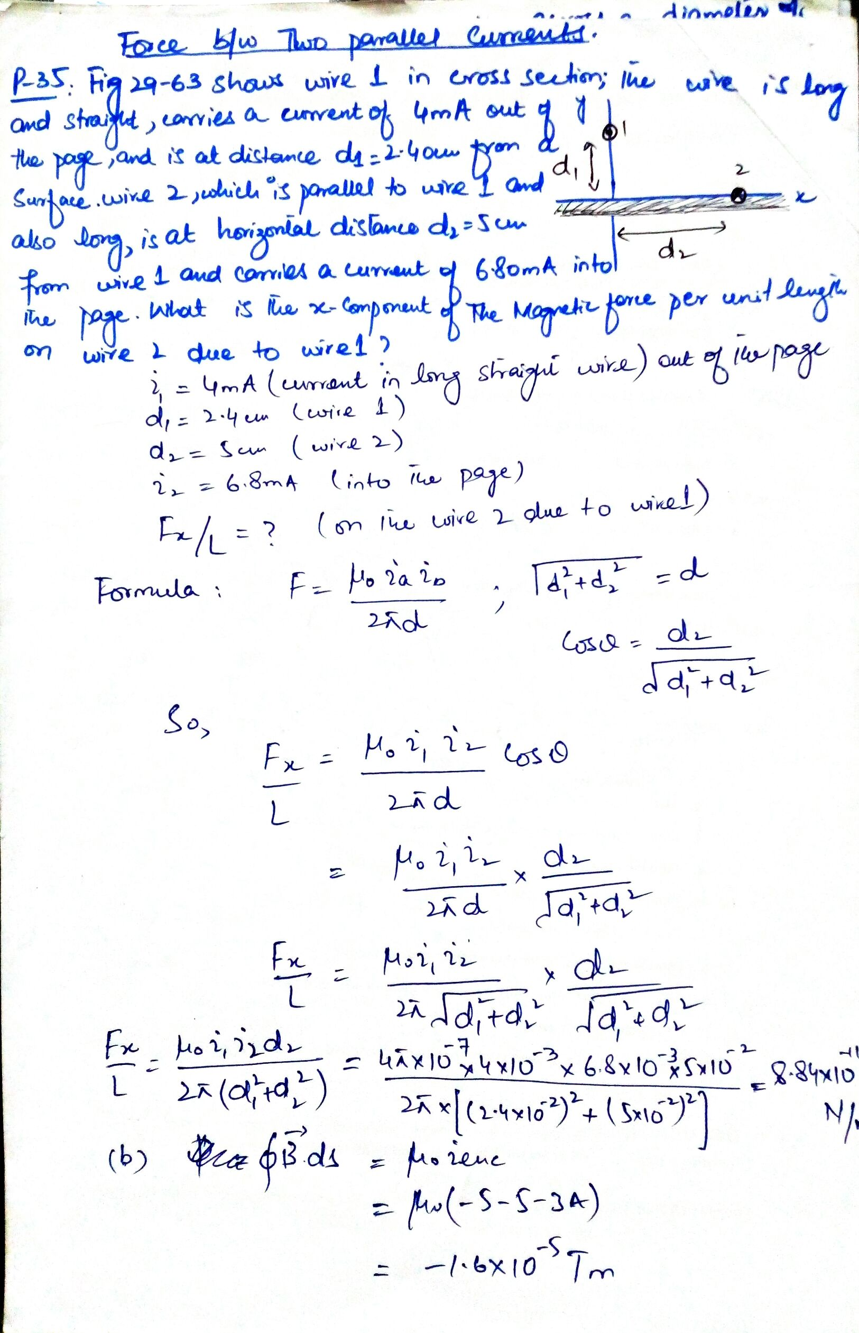

Slide 16
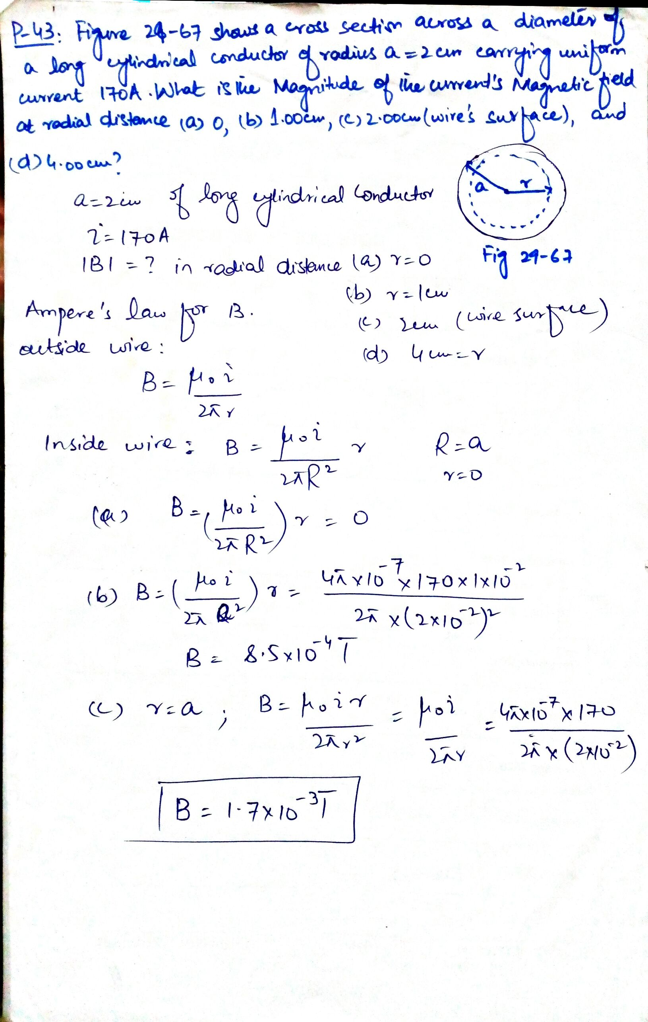

Slide 17
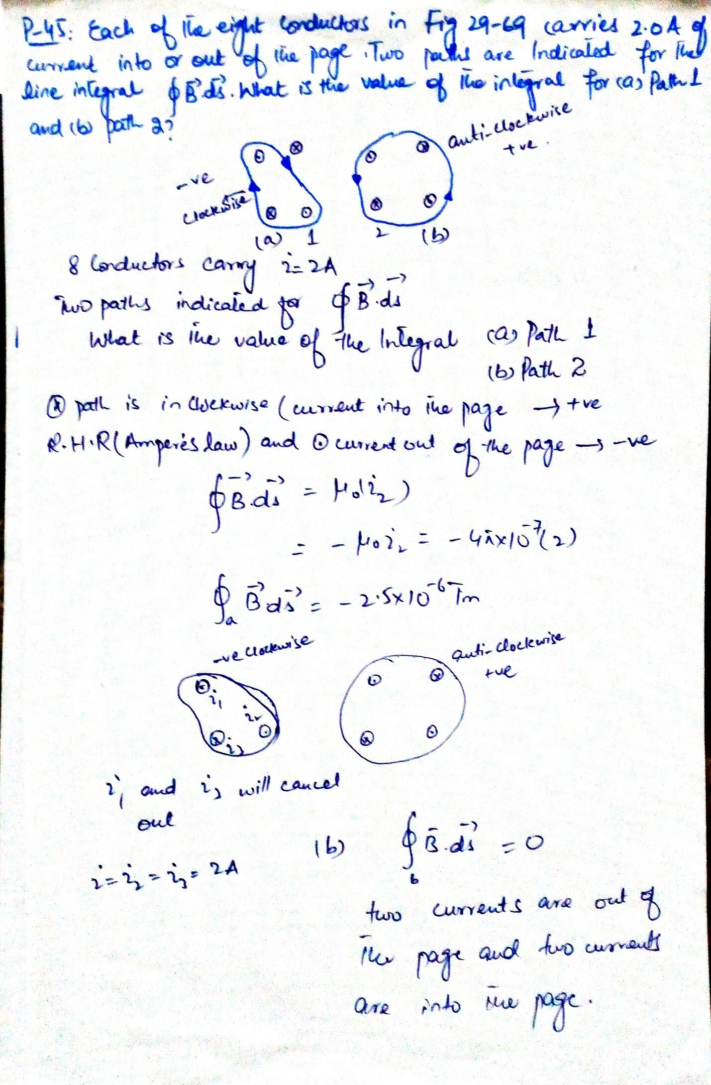

Slide 18
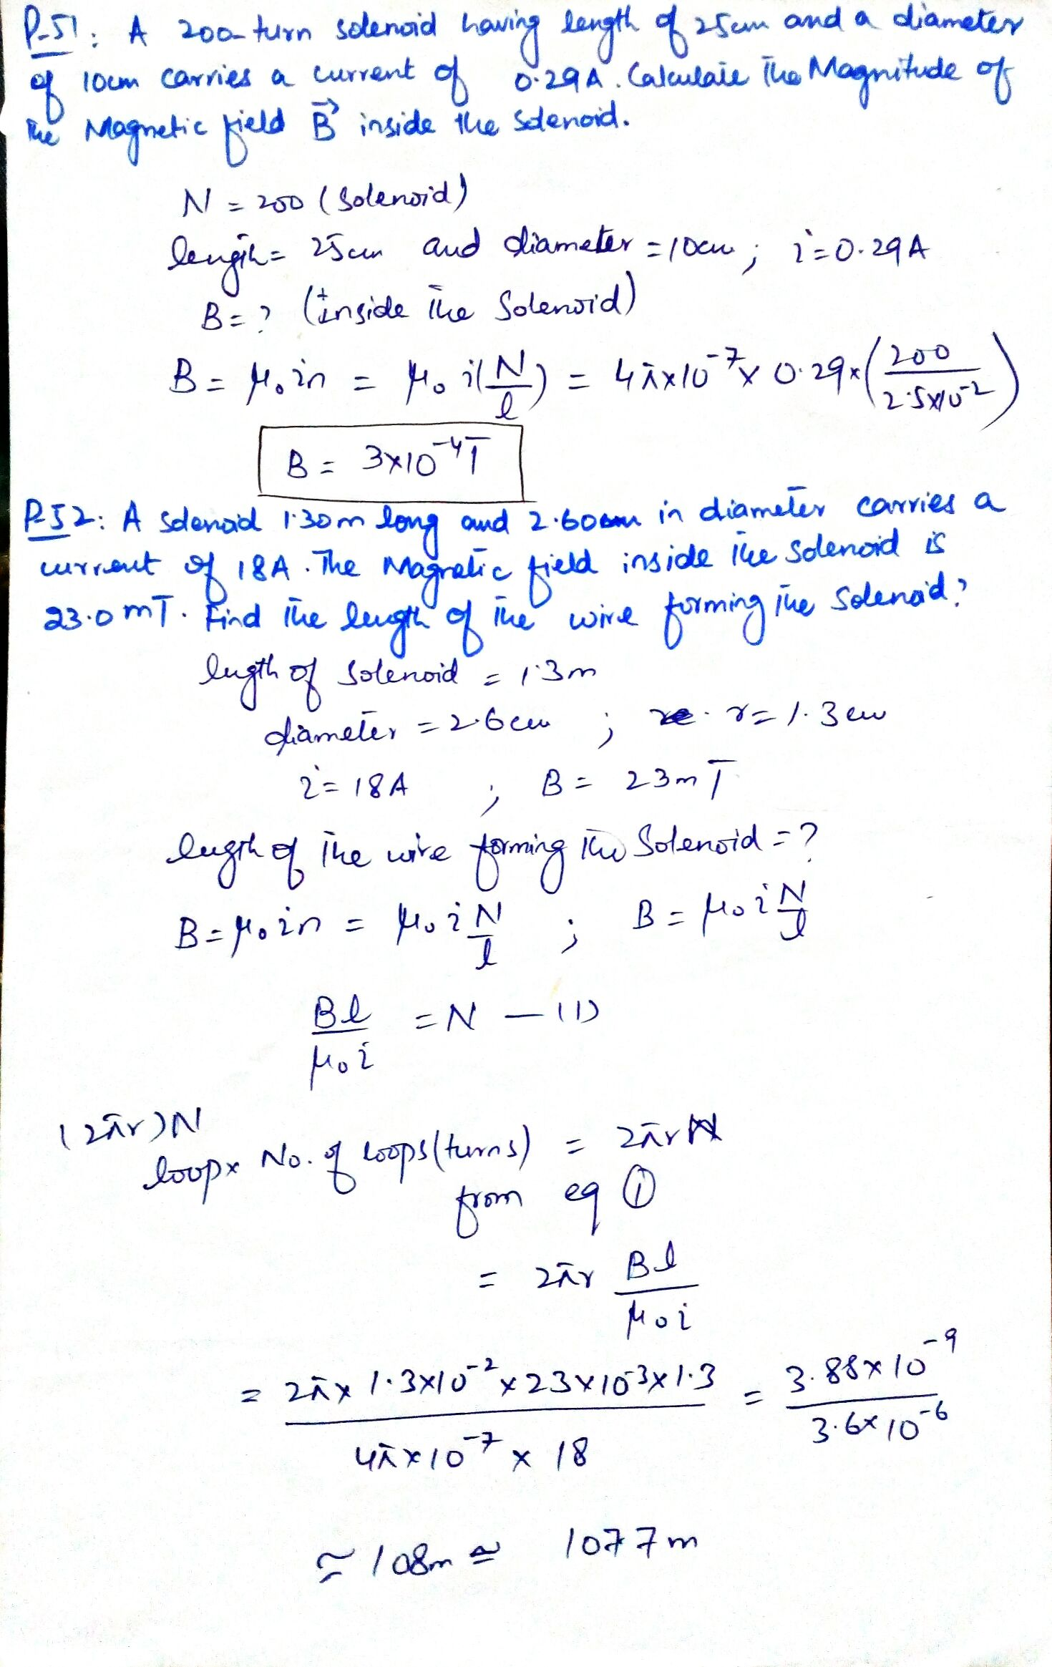

Slide 19
Chapter 29:
Exercise problems:
1, 3, 35, 36, 45, 43, 49, 51, 52, 53
Sample problems:
29.03, 29.04

